Slide 1

Correlation Analysis
(Part-2)

Slide 2
Objectives
Find out Whether there is any relation between or among of the variables.
Strength of the relationship.
2

Slide 3
OUTLINE
Measure correlation by correlation co-efficient (r)
Interpretation of r
Properties of r
Advantages, disadvantages and uses of correlation coefficient.
Exercise.
3

Slide 4
METHODS OF STUDYING CORRELATION
Correlation can be studied by the following methods:
Scatter Diagram Method
Karl Pearson’s Correlation Coefficient
We will practice the maths of this technique.

Slide 5
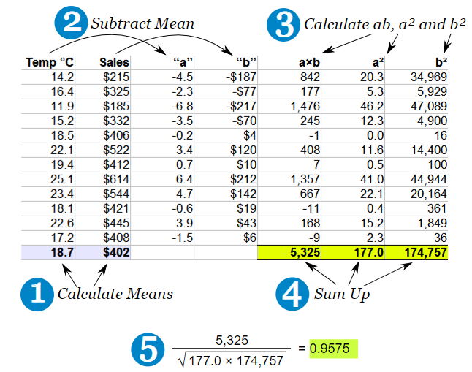

Calculation of correlation by Karl Pearson’s Correlation Coefficient
2. Karl Pearson’s Correlation Coefficient
$$r =\frac{\sum_{i=1}^{n}{(X_{i}− \overline{X})(Y_{i}− \overline{Y}) }}{\sqrt{\sum_{i=1}^{n}{({X_{i}− \overline{X})}^{2}}}\sqrt{\sum_{i=1}^{n}{({Y_{i}− \overline{Y})}^{2}}}}$$
Where, n= number of pairs in sample.

Slide 6
Example of correlation calculation
Problem: Mr. Johnson is concerned about the cost to students of textbooks. He believes there is a relationship between the number of pages in the text and the selling price of the book. To provide insight into the problem he selects a sample of eight textbooks currently on sale in the bookstore. Compute the correlation coefficient.
a) Draw Scatter diagram
b) Determine the coefficient of correlation
c) Interpret the result.

Slide 7
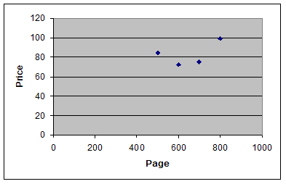

Example of correlation calculation
Solution:
a) Scatter diagram:
b) Here,
We know, Correlation coefficient,
$$r =\frac{\sum_{i=1}^{n}{(X_{i}− \overline{X})(Y_{i}− \overline{Y}) }}{\sqrt{\sum_{i=1}^{n}{({X_{i}− \overline{X})}^{2}}}\sqrt{\sum_{i=1}^{n}{({Y_{i}− \overline{Y})}^{2}}}}$$
Where,

Slide 8
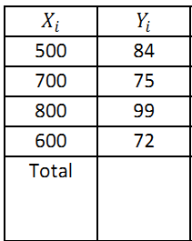
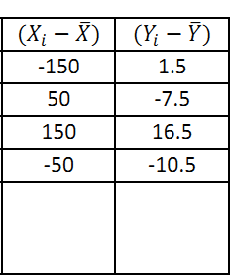
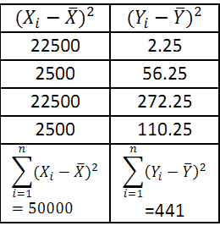
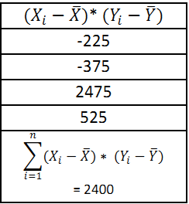
Example of correlation calculation

Slide 9

Example of correlation calculation
Now,
From the correlation coefficient

Slide 10
Example of correlation calculation
c) Interpretation: The correlation between the number of pages and the selling price of the book is 0.511. This indicates a moderate association between the variables.
Correlation Coefficient Interpretation:
Coefficient Range | Strength of Relationship
0.00 - 0.20 | Very Low
0.21 - 0.40 | Low
0.41- 0.60 | Moderate
0.60 - 0.80 | High Moderate
0.81- 1.00 | Very High

Slide 11
Properties of correlation coefficient
2. Correlation coefficient has no unit.
3. Correlation coefficient can only measures linear relationship.
4. Correlation coefficient can only be measured for quantitative variables.

Slide 12
Criteria of Correlation coefficient

Slide 13
Some exercise Problems to solve
Find Correlation coefficient and interpret it.
Draw scatter diagram.

Slide 14
Some exercise Problems to solve
Find Correlation coefficient and interpret it.
Draw scatter diagram.

Slide 15


